Slide 1


City VS Resort Hotel
HOTEL BOOKING DATA ANALYSIS
Presented By: Snehal Nalawade
Tools: Excel | Power BI

Slide 2

Project Objective
Dataset Overview
Tools & Technologies
Data Preparation & Cleaning
Feature Engineering
Dashboard & insights
Business Recommendation
Challenge Faced
Conclusion
Content

Slide 3





Project Objective
Analyze booking patterns across City and Resort hotels
Identify key revenue drivers
Understand guest behavior and preferences
Evaluate cancellation trends
Provide data-driven recommendations to
improve hotel performance

Slide 4
Dataset Overview
Contains 3 years of booking data (2015–2017)
119,000+ booking records
Includes City Hotel and Resort Hotel records
Captures booking details, guest demographics, and stay duration
Provides pricing information through Average Daily Rate (ADR)
Includes cancellation data for trend analysis

Slide 5


Tools & Technologies
Technology Stack Used in the Project
Power BI → Interactive dashboard & visualization
Power Query → Data cleaning and transformation (ETL process)
Excel → Initial data exploration

Slide 6

Data Preparation & Cleaning
Removed duplicate records to maintain accuracy
Handled missing values using appropriate replacements
Standardized categorical fields for consistency
Eliminated irrelevant columns to improve performance
Created a Primary Key (Booking ID) for unique identification

Slide 7
Feature Engineering
To enhance analytical capabilities, several calculated fields were created:
Total Guests = Adults + Children + Babies
Total Stay = Weekend Nights + Week Nights
Total Revenue = ADR × Total Stay
Cancellation Status to track booking outcomes
Lead Time Categories to understand booking behavior
Guest Type Segmentation (Single, Couple, Group)

Slide 8
Feature Engineering: DAX Query
Guest Type :
Guest Type =
SWITCH(
TRUE(),
'Hotel Booking'[adults] = 1, "Single",
'Hotel Booking'[adults] = 2, "Couple",
'Hotel Booking'[adults] >= 3, "Group",
"Other"
)
Week of Day :
Week of Day =
IF(WEEKDAY('Hotel_Bookings__1'[Arrival_Date],2)==1,"Monday",
IF(WEEKDAY('Hotel_Bookings__1'[Arrival_Date],2)==2,"Tuesday",
IF(WEEKDAY('Hotel_Bookings__1'[Arrival_Date],2)==3,"Wednesday",
IF(WEEKDAY('Hotel_Bookings__1'[Arrival_Date],2)==4,"Thursday",
IF(WEEKDAY('Hotel_Bookings__1'[Arrival_Date],2)==5,"Friday",
IF(WEEKDAY('Hotel_Bookings__1'[Arrival_Date],2)==6,"Saturday","Sunday"))))))

Slide 9
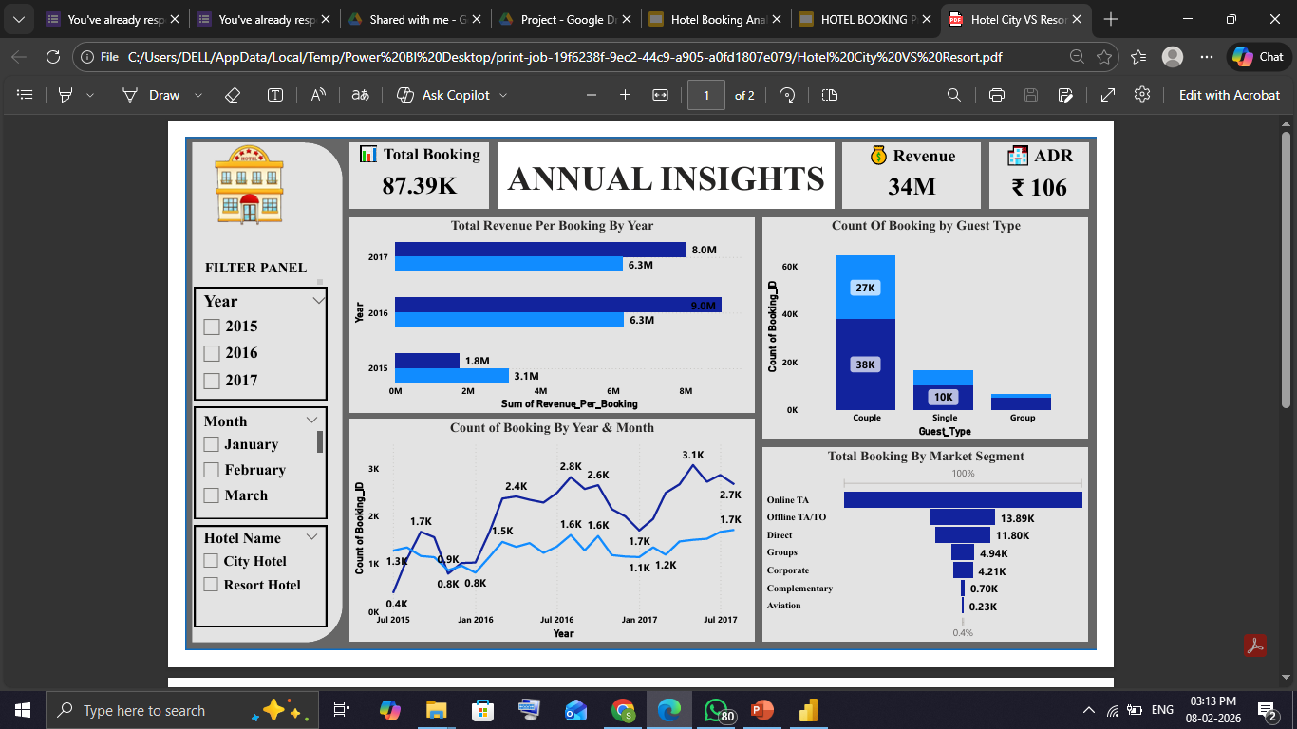
Interactive Dashboard

Slide 10
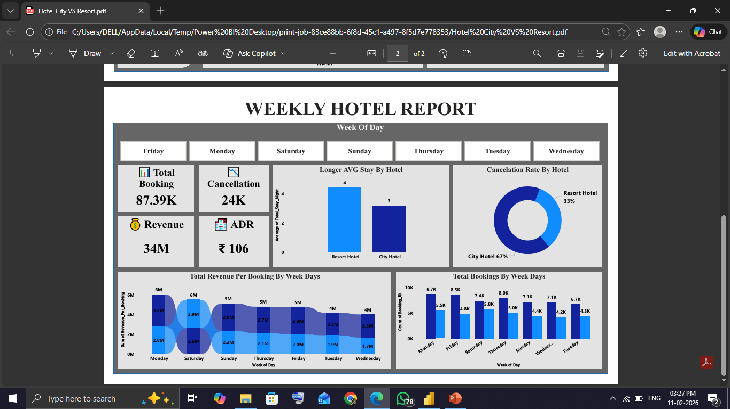
Interactive Dashboard

Slide 11

Key Insights
City Hotels recorded 22% higher booking volumes, likely driven by business travel.
Resort Hotels showed longer average stays, increasing revenue per booking.
Higher cancellation rates were observed in City Hotels..
Peak booking periods aligned with seasonal travel trends.
Couples represented the largest guest segment, indicating strong leisure demand
August is one of the peak months for bookings. Hotels should manage their resources during these months and conduct promotional activities during months with fewer bookings.
Longer lead times were associated with increased cancellation probability.

Slide 12

Strategic Recommendations by Hotel Type
City Hotel — Revenue Protection Strategy
Implement predictive overbooking using historical cancellation trends to minimize revenue loss from unoccupied rooms.
Promote direct bookings through exclusive perks to reduce third-party commission costs and improve profit margins.
Target corporate clients and business travelers to stabilize weekday occupancy.
Introduce flexible cancellation or rescheduling options to build customer trust while lowering last-minute cancellations.
Apply dynamic weekday pricing to capitalize on consistent business travel demand.
👉 Key Focus: Revenue protection and occupancy stabilization.
🏨

Slide 13
Strategic Recommendations by Hotel Type
Resort Hotel — Demand Generation Strategy
Design attractive vacation packages by bundling accommodation with dining, spa, and recreational activities.
Launch early seasonal marketing campaigns to capture advance bookings from leisure travelers.
Encourage longer stays through discounted multi-night offers to increase revenue per guest.
Strengthen digital marketing and social media presence to enhance visibility among travelers.
Develop loyalty programs to convert first-time guests into repeat customers.
👉 Key Focus: Demand creation and guest experience enhancement.
🌴

Slide 14
Challenges Faced
Handling missing and inconsistent data
Transforming raw data into meaningful metrics
Selecting the most impactful KPIs
Designing a dashboard that balances detail with clarity

Slide 15

Conclusion
Increase occupancy through targeted demand strategies
Minimize revenue loss by proactively managing cancellations
Implement dynamic pricing to maximize profitability
Strengthen customer retention through personalized guest experiences
Align marketing efforts with high-value customer segments

Slide 16




THANK YOU

